Slide 1
Adrenal gland disorders
Dr.Dulani Kottahachchi
Consultant Endocrinologist
Faculty of medicine ,
Ragama

Slide 2
Overview
Primary ahypoadrenalism/Addison disease
Cushings syndrome
Hyperaldosteronism
Phaeochromocytoma

Slide 3
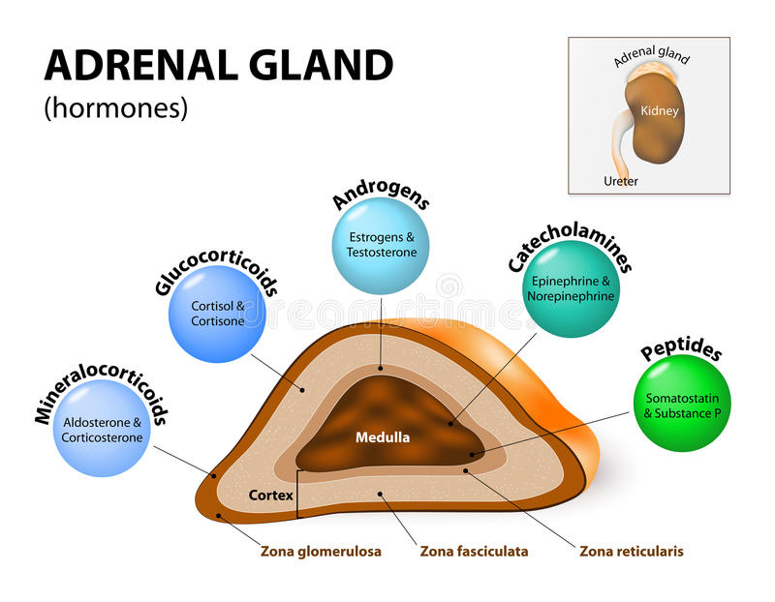

Slide 4
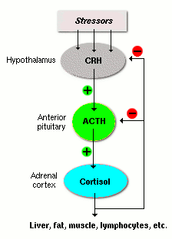

Slide 5
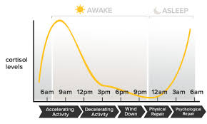
Diurnal Variation in secretion

Slide 6
Primary Hypoadrenalism – Addison Disease

Slide 7
Adrenal Insufficiency
Occurs due to lack of glucocorticoids ± aldosterone
Life threating condition
Can lead to circulatory collapse

Slide 8
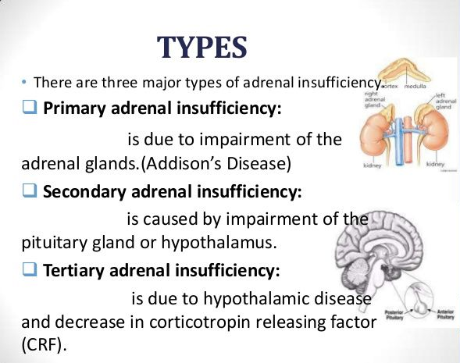

Slide 9
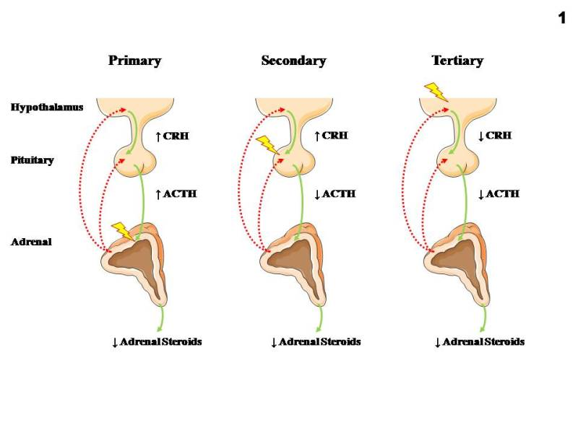

Slide 10
Introduction
Destruction of adrenal cortex
↓ Cortisol → ↑ CRH & ACTH
Rare – incidence 3-4/million/year prevalence 40-60/million
Females > Males

Slide 11
Causes
Autoimmune disease –antiadrenal antibodies
Tuberculosis
Surgical removal of adrenals (adrenalectomy)
Haemorrhage / Infarction – meningococcal septicaemia
Infiltration
Metastatic disease
Adrenal leukodystrophy

Slide 12
Symptoms
Vague & non-specific – malaise, weakness
Pigmentation (in >90%)
Postural hypotension (in >80%) → pre-syncope and syncope
LOA & LOW
Depression
Nausea, vomiting, diarrhoea
Impotence, amenorrhoea

Slide 13
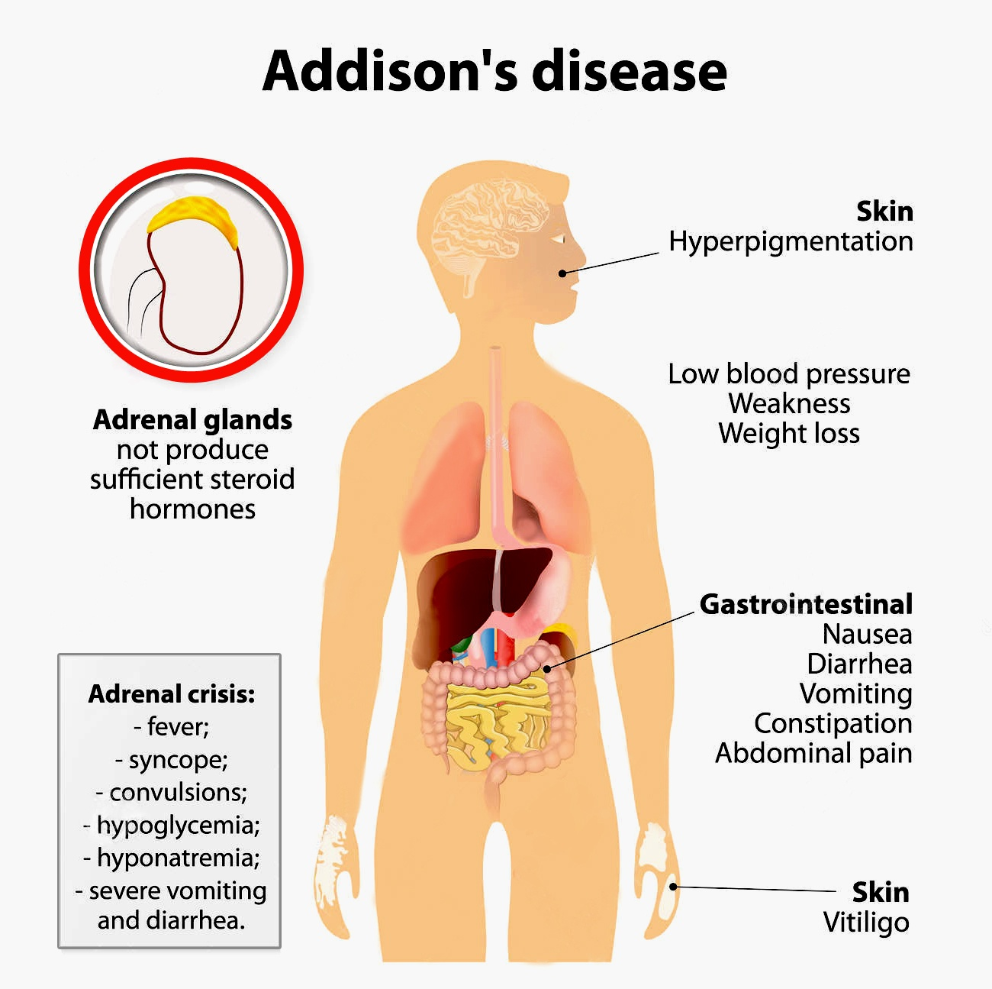

Slide 14
Signs
Pigmentation –
new scars
palmar creases
buccal
Postural hypotension
LOW and generalised wasting
Dehydration
Loss of body hair
Vitiligo

Slide 15
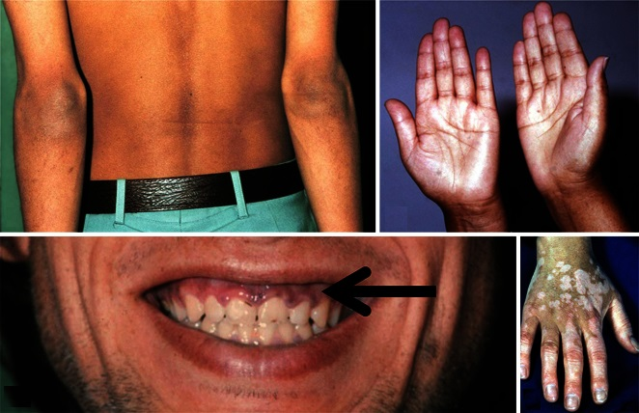

Slide 16
Addisonian Crisis
Precipitated by intercurrent illness, trauma, surgery, etc
Life threatening – medical emergency
Salt, steroid & glucose deficiency
Severe dehydration
Hypotension
Hypoglycaemia

Slide 17
Investigations
Random cortisol – of little value
If <100 nmol/L during day → highly suggestive
If >550 nmol/L → unlikely
Short ACTH stimulation test –
Tetracosactide 250 microg i.v/im at 0 mins
Plasma cortisol at 0 , 30 mins ,1 hour
If cortisol at 30 mins/1 hour is >550 nmol/L → excludes primary adrenal failure
9 am plasma ACTH –
If high with low/low normal cortisol → confirms primary adrenal failure

Slide 18
Investigations
↑ potassium & urea, ↓ sodium
↓ glucose
↓ aldosterone, ↑ renin
↑ calcium
Anaemia
Adrenal Abs
Chest & Abdo Xrays for TB

Slide 19
Treatment – Acute Hypoadrenalism
N. saline + Hydrocortisone i.v
Hydration is the most important initial step
Glucose iv/oral
Oral steroids once stable
Fludrocortisone later

Slide 20
Treatment – Long Term
Treat underlying cause if possible – TB
Replacement with
(a) Glucocorticoid – oral hydrocortisone
- oral prednisolone
(b) Mineralocarticoid - fludrocortisone

Slide 21
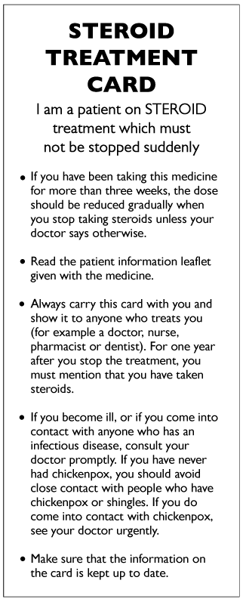

All patients on steroid replacement should -
Know how to increase steroid dose for inter-current illness
(Double the existing dose during the illness)
Carry a ‘steroid card’
Have vial of iv hydrocortisone with
them

Slide 22
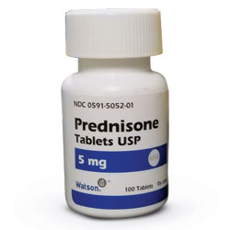
Secondary Hypoadrenalism
Hypothalamic-pituitary disease
→ inadequate ACTH production
Pitutary tumour/infiltration/infections
Differs from primary hypoadrenalism
No salt wasting or hyperkalemia
No hyperpigmentation
Long term steroid therapy
→ hypothalamic-pituitary-adrenal suppression

Slide 23
Cushing Syndrome

Slide 24
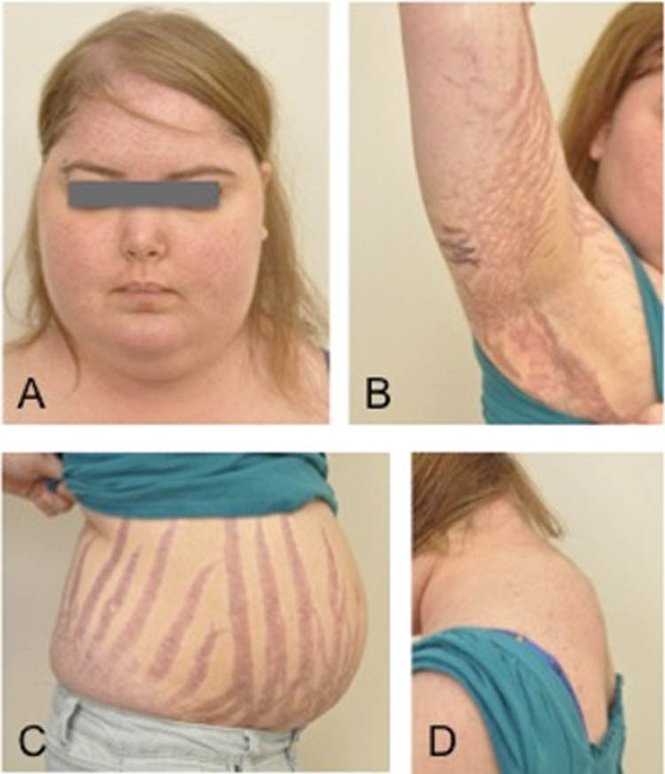
Cushing Syndrome
Due to prlong increase in plasma glucocorticoids
Described by Harvey Cushing
Can be ACTH dependent or Independent

Slide 25
Introduction
Increased free circulating glucocorticoid
Commonly due to therapeutic synthetic steroids (or ACTH) administration
All spontaneous forms are rare
< 5/million/year

Slide 26
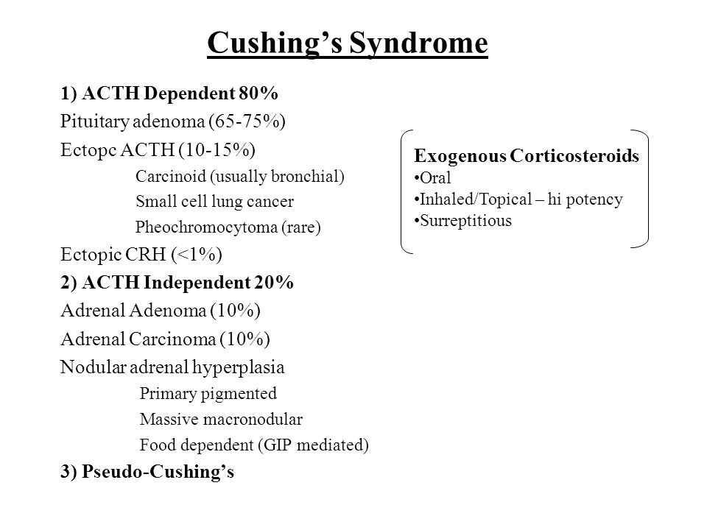

Slide 27
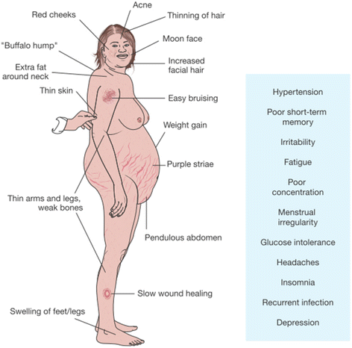

Slide 28
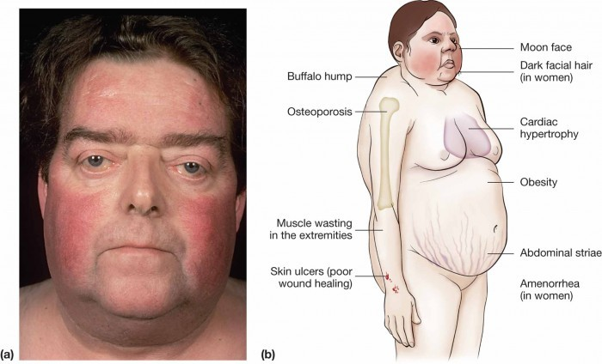

Slide 29
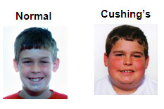
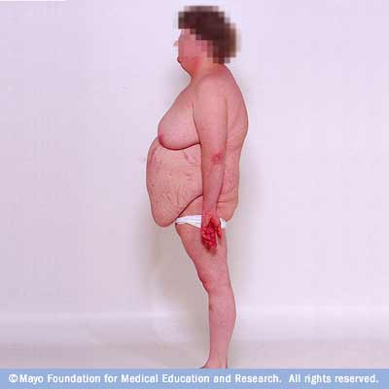
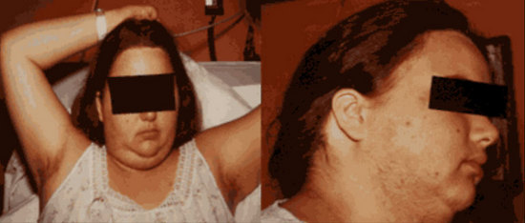
Symptoms
Weight gain, change in appearance
Insomnia
Depression
Psychosis
Amenorrhoea/oligomenorrhoea
Poor libido
Polyuria, polydipsia

Slide 30
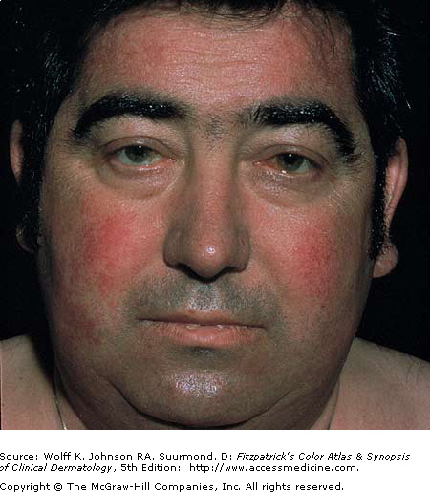
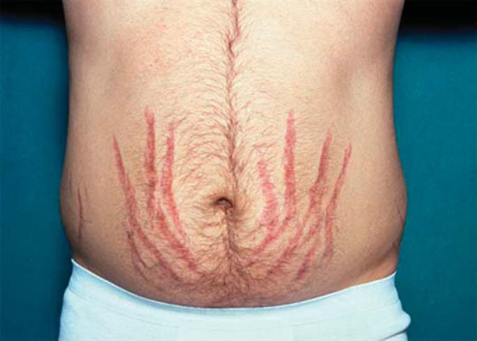
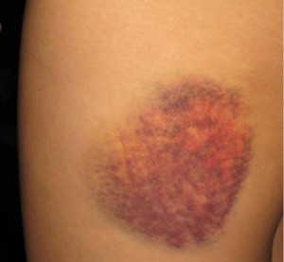
Signs - Discriminatory
Plethora
Thin skin
Easy bruising
Hypertension
Pathological fractures
vertebrae, ribs
Striae – purple/red
Proximal myopathy

Slide 31
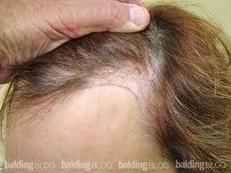
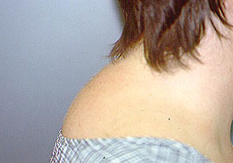
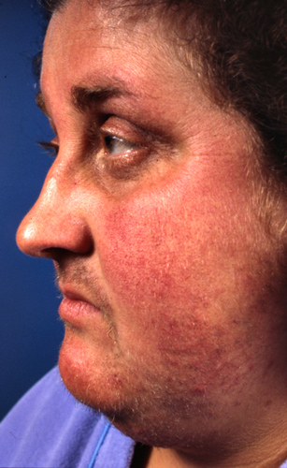
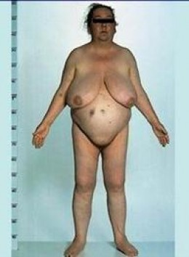
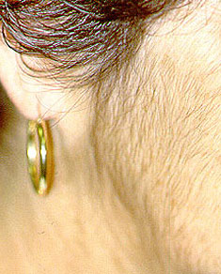
Signs
Moon face
Buffalo hump
Central obesity
Acne
Hirsuitism
Frontal balding (females)
Osteoporosis
Oedema
Glycosuria

Slide 32

Other Clinical Features
Pigmentation
only in ACTH-dependant causes
Cushingoid appearance
in excess alcohol consumption
IGT or Diabetes mellitus
ectopic ACTH
Hypokalaemia
ectopic ACTH

Slide 33
MOST obese, hirsute & hypertensive patients do NOT have Cushing’s syndrome
Obesity & depression alter cortisol dynamics in normal people
Random cortisol – useless
‘Cyclical Cushing’s’

Slide 34
Confirming Diagnosis
Overnight dexamethasone suppression test – 1 mg at 11 pm – cortisol at 9 am
normal < 50 nmol/L
outpatient screening
High sensitivity
(Normal test rules out Cushings Syndrome)
48-hour low-dose dexamethasone suppression test –
0.5 mg qds
9 am plasma cortisol at 0 & D2
normal <50 nmol/L on D2
highly sensitive

Slide 35
Confirming Diagnosis
24-hour urinary free cortisol
simple but less reliable
Circadian variation
cortisol at 9 am & 11 pm
Cushings – high midnight level
ACTH level

Slide 36
Differential Diagnosis of Cause
All causes → clinically identical Cushing’s syndrome
Ectopic ACTH – short history
pigmentation
LOW
low potassium
DM
high plasma ACTH
Adrenal tumour – severe hirsutism & virilization

Slide 37
Differential Diagnosis of Cause
Adrenal CT or MRI –
tumours are large
bilateral adrenal hyperplasia → ACTH-dependant
ACTH-independant nodular hyperplasia
Pituitary MRI
Plasma potassium – ectopic ACTH
High-dose dexamethasone suppression test – 2 mg qds
9 am plasma cortisol at 0 & D2
Suppression → pituitary disease
No significant suppression → ectopic ACTH
adrenal tumour

Slide 38
Differential Diagnosis of Cause
Plasma ACTH
if low → non-ACTH dependant disease
CRH test
exaggerated response → pituitary-dependant
Chest X-ray
bronchial CA or carcinoid
Selective catheterization of inferior petrosal sinus, to measure ACTH level (pituitary-dependant)
Blood samples from whole body (ectopic)
Radiolabelled octreotide (ectopic)

Slide 39
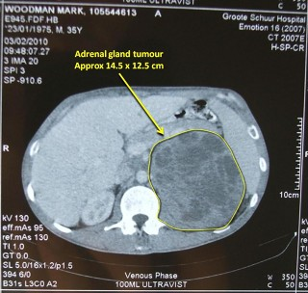
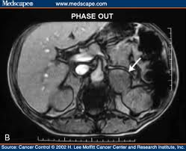
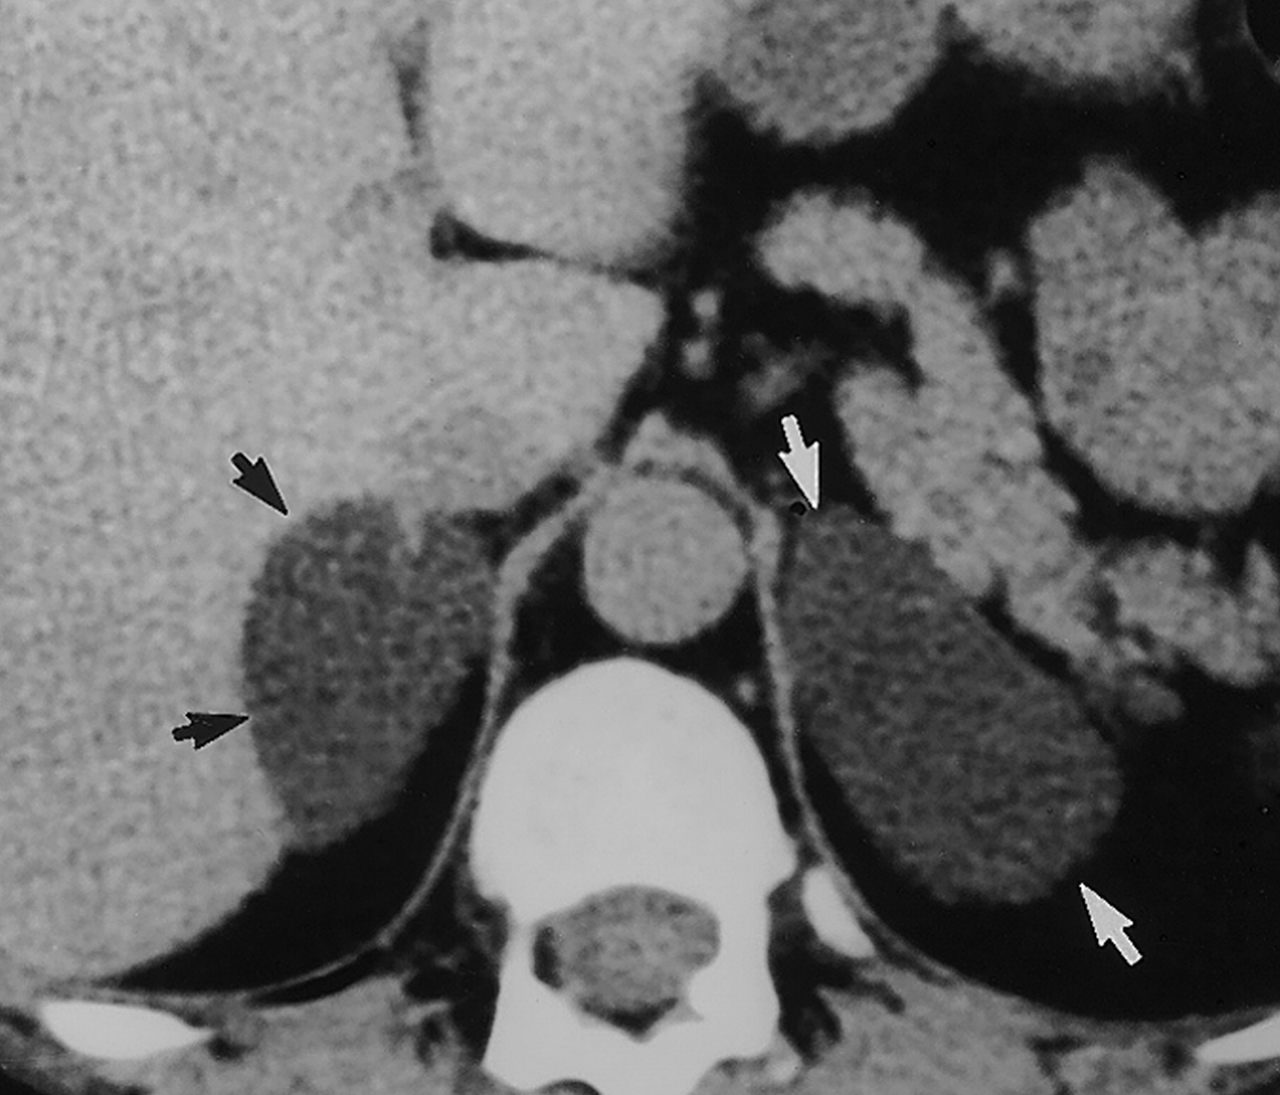
Imaging of adrenal glands

Slide 40
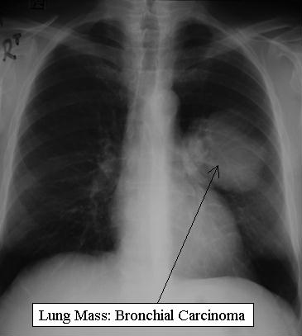
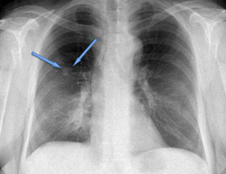
Chest X-ray

Slide 41
Treatment
Untreated → bad prognosis
Cortisol hypersecretion MUST be controlled prior to surgery or radiotherapy
Using Metyrapone (11β-hydroxylase blocker) with Ketoconazole synergistically

Slide 42
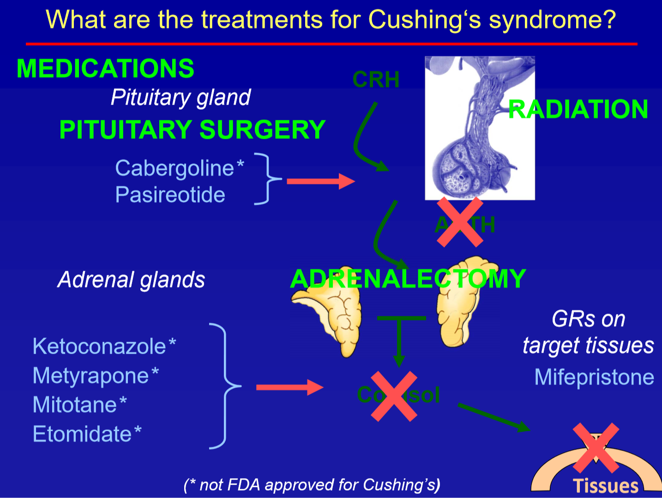

Slide 43
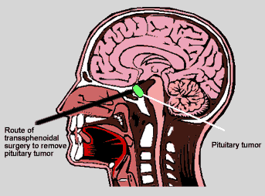
Treatment of Pituitary-Dependent Hyperadrenalism (Cushing Disease)
Trans-sphenoidal tumour removal
best with remission in 75-80%
External pituitary irradiation
mainly used after failed pituitary surgery
Medical therapy
rarely effective
Bromocriptine, Cyproheptadine
Bilateral adrenalectomy
last resort

Slide 44
Treatment of Hyperadrenalism
Adrenal Adenoma
resection
Adrenal Carcinoma
aggressive → poor prognosis
surgical reduction of tumour bulk
chemotherapy (mitotane)
radiotherapy
Tumours secreting ACTH ectopically
surgical removal if possible
chemo & radio-therapy
bilateral adrenalectomy

Slide 45
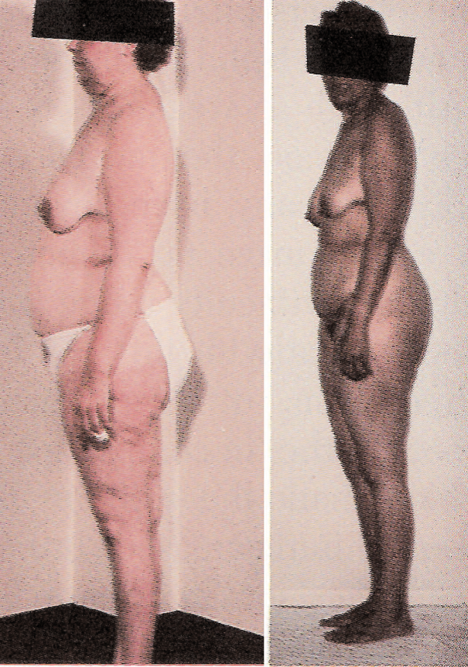
Nelson’s Syndrome
Increased pigmentation (↑ ACTH) due to enlarging pituitary tumour
In 20% after bilateral adrenalectomy for Cushing’s Disease
Rare
Surgery or radiotherapy

Slide 46
Disorders of Aldosterone Secretion

Slide 47
Aldosterone
Mineralocorticoid
Produced in adrenal cortex
Acts on distal renal tubule/CD
Maintains sodium & potassium balance in ECF

Slide 48
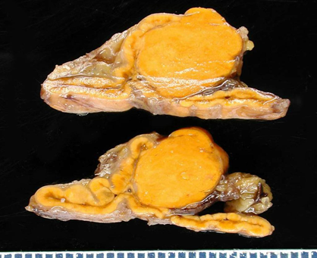
Primary Hyperaldosteronism
Sodium retention
Hypertension
Potassium loss → hypokalaemia
Adrenal adenoma (Conn’s syndrome)
young woman
Bilateral adrenal hyperplasia
older men
Severe (secondary) hypertension (accounts for 5-10% of all hypertension)
Non-specific symptoms
muscle weakness, nocturia, tetany

Slide 49
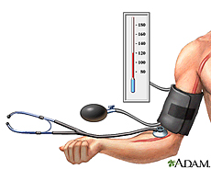
Management
Investigations –
Plasma aldosterone:renin ratio
↑ plasma aldosterone
↓ plasma renin
hypokalaemia
increased urinary K loss
Confirmatory testing before treatment
Treatment –
surgical resection
spironolactone (aldosterone antagonist)

Slide 50
Secondary Hyperaldosteronism
With hypertension –
accelerated hypertension
renal artery stenosis
Without hypertension –
congestive cardiac failure
cirrhosis
Useful drugs → ACEI
ARB
Spironolactone

Slide 51
Phaeochromocytoma

Slide 52
Introduction
Catecholamines - produced in adrenal medulla
Noradrenaline (norepinephrine)
Adrenaline (epinephrine)
Play a part in BP control

Slide 53
Pheochromocytoma are v rare
Prevalence 0.01 % to 0.1 %
Equally in men and women
Tumours of sympathetic nervous system
90% in adrenals
25% multiple
10% malignant
Associations - MEN II
von Hippel Lindau syndrome

Slide 54
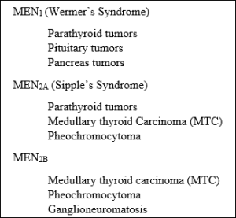

Slide 55

Symptoms
May be intermittent
Anxiety, panic attacks
Palpitations, tremors
Headache
Sweating, flushing
Nausea, vomiting
Weight loss
Constipation or diarrhoea
Chest pain

Slide 56

Signs
Hypertension
Tachycardia/bradycardia/arrhythmias
Orthostatic hypotension
Pallor or flushing
Glycosuria
Fever

Slide 57
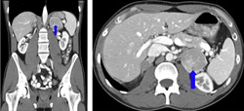
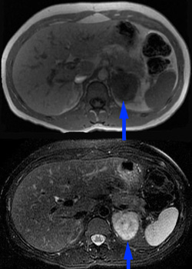
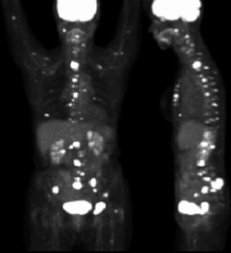
Investigations
Measurement of urinary
catecholamines (metanephrine)
Resting plasma
catecholamines
CT or MRI
abdomen
MIBG scan

Slide 58
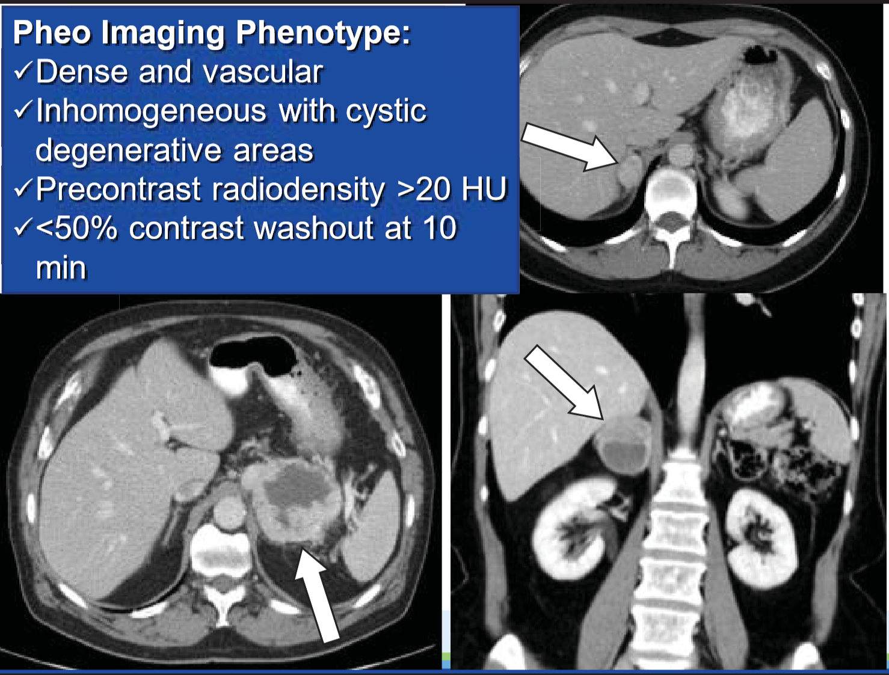

Slide 59
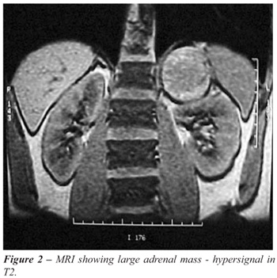

Slide 60
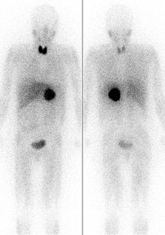
MIBG scan

Slide 61
Treatment
Ideally surgical resection
Pre-op
complete alpha blockade (phenoxybenzamine)
then beta blockade (Propranolol)
If surgery is not possible → combined
alpha & beta blockade long term

Slide 62
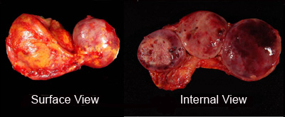

Slide 63

Case 1
A 29 year-old woman with type 1 diabetes and hypothyroidism presents to her endocrinologist with progressive fatigue and weight loss. Her only medications are a brand-name levothyroxine preparation and insulin Aspart via an insulin pump. A recent TSH was within normal limits. Her diabetes is in excellent control as evidenced by her recent hemoglobin A1c of 6.4 % (Nl 4.3-5.8), though she does report an increased frequency of hypoglycemic episodes. Physical exam is notable for a blood pressure of 88/ 56 mmHg and modest hyperpigmentation of the buccal mucosa.
Adrenal insufficiency is suspected.
3.

Slide 64
The most useful initial test in this patient would be:
A. Metyrapone test
B. Midnight salivary cortisol
C. Cortrosyn stimulation test
D.24 hour urine collection for free cortisol
E.None of the above

Slide 65
The most likely cause of adrenal insufficiency in this patient would be:
A. Autoimmune adrenalitis
B. Tuberculosis
C. Pituitary tumor
D.Adrenoleukodystrophy
E. None of the above

Slide 66
Treatment would most likely include
A. Glucocorticoid but not mineralocorticoid
B Mineralocorticoid but not glucocorticoid
C. Both glucocorticoid and mineralocorticoid
D. Neither glucocorticoid nor mineralocorticoid
E. None of the above

Slide 67
Which of the following abnormalities is present typically in patients with type 2A multiple endocrine neoplasia:
A. Medullary thyroid carcinoma, pheochromocytoma, parathyroid hyperplasia
B. Parathyroid carcinoma and jaw tumors
C. Pancreatic endocrine tumors and pituitary adenomas
D. Renal cell carcinomas and pheochromocytomas
E. Parathyroid hyperplasia and pituitary tumors

